Slide 1
Biomimicry Design Process
Notes:
use examples in nature instead of living examples?

Slide 2
Bio-inspired Design Process
A 5 step process to investigate a problem and use engineering ideas from from nature to help solve it.

Slide 3
Technological Challenge
- A laundry detergent company wants to make a new and better laundry detergent

Slide 4
DECODING
Translate the challenge into functional terms
What do you want to accomplish using everyday english?
Notes:
Answer: Keeping Clothes Clean

Slide 5
DISCOVERING
Look at the natural world for engineering ideas
Find living examples with abilities similar to our challenge’s functional needs
Find living examples that match your functional needs
Notes:
Shark and Lotus Leaf

Slide 6
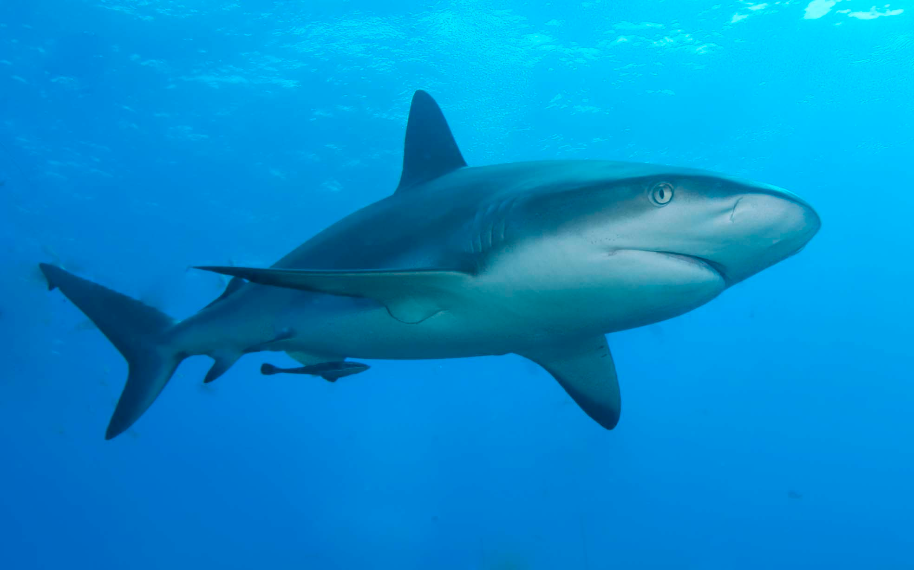
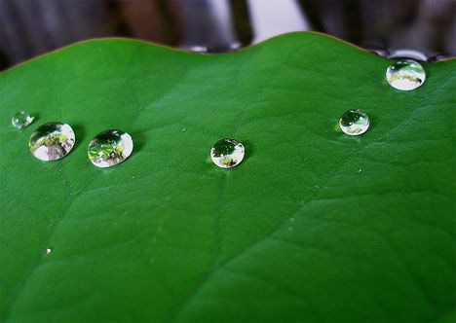
DISCOVERING
Examples
Shark - The texture of sharks skin creates anti-bacterial qualities
Lotus Leaf - As water hits the leaf it immediately rolls off the leaf bringing with it any dirt or foreign particles.

Slide 7
ABSTRACTING
Put into words what it is about our living examples that makes us think they are good models to help us solve the challenges we’re facing.
Remove the biological terms or plant/animal specific terminology
Keep the scientific principles

Slide 8
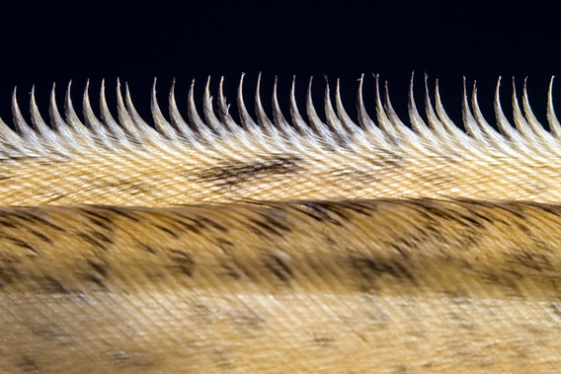
Read the following description and figure out the design principle that would help solve the problem
“Unlike wings of other birds, most owl species’ wings are serrated on the leading edge. The serrations give the owl a better ability to control airflow, therefore allowing owl to fly faster and to reduce noise…Nature’s solution for owls is having… several tips (serrations) on their wings, therefore creating several
microturbulences instead of one strong
turbulence, therefore the noise heard
is much less.”
Abstraction: Serrated edges create micro-turbulences which decrease noise and drag

Slide 9
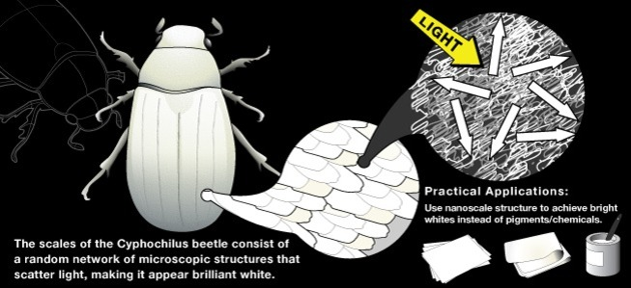
Read the following description and figure out the design principle that would help solve the problem
“Beetles in the Cyphochilus genus achieve their striking white coloration not through chemical pigments, but through a disordered tangle of 250 nm-diameter filaments in their scales. The fibers are sparsely packed with just the right number of voids, giving rise to a thorough scattering of light that causes the brilliant whiteness. The secret is not in the material itself, but the
structure—the way the meshwork
of fibers and voids scatters the light.
Unlike colors, which can be created
by using highly ordered structures
to scatter light, white is created by
a random, simultaneous scattering
of light.”
Notes:
Abstraction: Fibers scattered an appropriate distance from each other can produce different colours of light depending on the distances

Slide 10
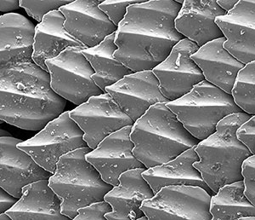
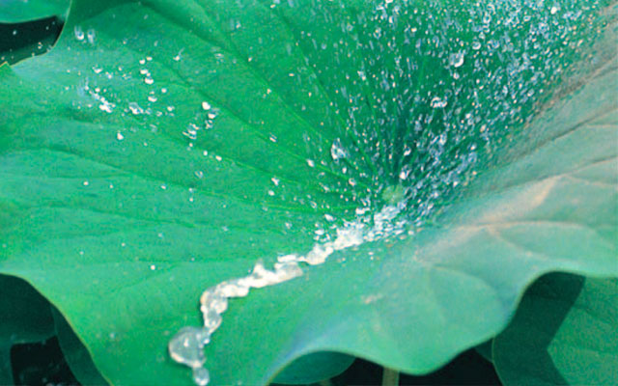
ABSTRACTING
Shark - An uneven surface creates differences in pressure which allows foreign material to be removed
Lotus Leaf: Water spilled on a superhydrophobic surface does not wet the surface, but simply rolls off. As water moves across the superhydrophobic surface, it picks up and carries away any foreign material, such as dust or dirt.

Slide 11
APPLYING
Start creating and communicating your innovative engineering ideas
Apply what you have learned from your living examples and find a solution to your challenge

Slide 12
EVALUATING
Will it work?
Is it sustainable?
Does the design create any new problems?

Slide 13
YOUR TURN!
Choose one of the following technological challenges and complete the sheet provided:
1. A sports field is very wet, almost too wet, after a rain storm.
2. Black ice appears towards the top of the mountain road when driving up to Mt. Seymour.
3. I dropped my iPhone again! Why does the screen break so easily.
4. My school sweater becomes saturated quickly with water when playing soccer at lunch in the rain.

